Slide 1
Public Consultation: The Chickasaw Nation Disadvantaged Business Enterprise Program Goal and Methodology FY 2022-2024
Holly Bell, Procurement Compliance Manager, DBE Liaison Officer
Chickasaw Nation Tribal Procurement Department

Slide 2
DBE Program
Purpose: Allow for public comment on the Chickasaw Nations Disadvantaged Business Enterprise (DBE) Goal for FY 2022-2024
Per the Federal Transit Administration’s (FTA) regulations, when setting a DBE Goal, recipients of federal funds, must include a “scheduled, direct and interactive exchange” with the public to obtain feedback
Schedule: Background
Methodology
Next Steps and Public Comments/Questions

Slide 3
DBE Program (Cont.)
The Chickasaw Nation Tribal Procurement Department has an established Disadvantaged Business Enterprise (DBE) program and overall goal per the Federal Transit Administration’s (FTA) requirements on federally funded contracts
The DBE requirement applies to the Chickasaw Nation because we receive federal funds from the Federal Transit Administration (FTA)

Slide 4
DBE Program (Cont.)
Our proposed DBE Goal for FY 2022-2024 is 1.26%
The DBE goal setting methodology is prescribed by the federal regulation in 49 CFR Part 26 and can be found at ChickasawBusinessNetwork.com
All FTA funded agencies must follow the same methodology to reach their DBE goal

Slide 5
DBE Goal Setting
The four elements or steps of the goal setting process are outlined in 49 CFR 26.45(c-g) as follows:
The measurement of the actual relative availability of DBEs to perform anticipated contracting opportunities
Adjustment factor analysis to evaluate evidence of the effects of discrimination in jurisdiction and determine whether an adjustment is necessary
Calculation of the race/gender-conscious and neutral split for the goal attainment
Consultation and publication regarding the goal to facilitate public input
The DBE Goal and Consultation has been prepared in compliance with:
• DBE Regulations, 49 CFR 26.45, as amended,
ecfr.gov
• USDOT, “Tips for Goal Setting in the DBE Program” Tips for Goal Setting in the DBE Program

Slide 6
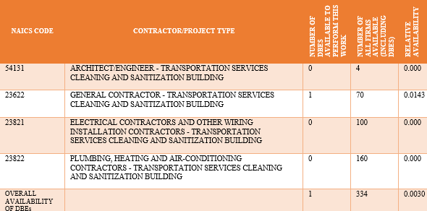
DBE Goal Setting (Cont.) Step 1: Developing a Base Figure
In determining the available pool, the relative availability (percentage) of Disadvantaged Business
Enterprise (DBE) firms within the Chickasaw Nation’s thirteen (13) treaty territory counties in Oklahoma:
Bryan County - Carter County - Coal County - Grady County - Garvin County
McClain County - Pontotoc County - Stephens County - Johnston County - Love County
Jefferson County - Murray County - Marshall County

Slide 7
DBE Goal Setting (Cont.) Step 1: Developing a Base Figure
The step one (1) calculation was performed by first determining the available pool of ready, willing and able DBE firms in each work category
Then the total number of all ready, willing and able firms was determined. The total number of firms includes both DBE firms and non-DBE firms
Finally, the number of DBE firms was divided by the number of all firms to arrive at the baseline ratio for each work category

Slide 8
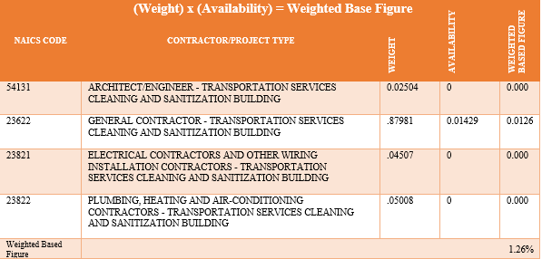
DBE Goal Setting (Cont.) Step 1: Developing a Base Figure
A bidder’s list was not used in the goal development. A bidder’s list could not be used because the Chickasaw Nation’s past purchasing records did not account for DBE utilization
The Chickasaw Nation sees an opportunity for DBE participation in future contracting activities, as well as an upcoming building project
The Chickasaw Nation chose to adopt a weighted approach in its DBE goal calculation
Those figures are then added together to determine the weighted based figure of 1.26%

Slide 9
DBE Goal Setting (Cont.) Step 2: Adjustment Factor Analysis
The Chickasaw Nation elected not to continue with a step two (2) adjustment to the weighted base figure
A prominent factor in an adjustment consideration is past participation. Past participation is the volume of work DBEs have performed on contracts in recent years
The Chickasaw Nation has not recorded DBE contract spend in the past. Therefore, DBE’s past participation data is not available
We were not able to use past participation, as a factor, so at this point the step one (1) weighted based figure of 1.26%, remains unchanged

Slide 10
DBE Goal Setting (Cont.) Step 3: Race Neutral – Race Conscious Goals
The Chickasaw Nation compared the draft goal from step two (2) to past participation by DBE prime
contractors
Due to the lack of DBE contract tracking data, our initial goal set will be set at 100% for
race/gender-neutral means of contracting
Using the Chickasaw Nation Business Network’s Preferred Vendor Program’s resources, our aim is to become acquainted with more potential DBEs so they feel encouraged to participate as a DBE contractor

Slide 11
DBE Goal Setting (Cont.) Step 4: Public Consultation
Questions and Comments:
The question and comment period is open for 30 days. You may email your questions and comments to: DBELO@Chickasaw.net

